Slide 1
Chapter Four
The Role of Culture in Developing Strengths and Living Well
Positive Psychology: The Scientific and Practical Explorations of Human Strengths © 2014 SAGE

Slide 2
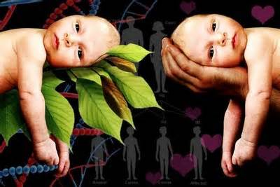
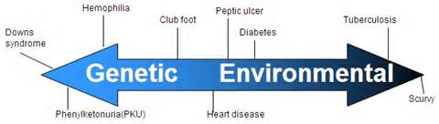
Nature vs. Nurture
Positive Psychology: The Scientific and Practical Explorations of Human Strengths © 2014 SAGE

Slide 3

Nature
Genetic influence on human psychological traits
Positive Psychology: The Scientific and Practical Explorations of Human Strengths © 2014 SAGE

Slide 4

Nurture
Positive Psychology: The Scientific and Practical Explorations of Human Strengths © 2014 SAGE

Slide 5
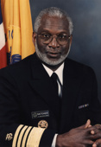
Culture Counts
David Satcher, 16th U.S. Surgeon General
In 2001 report he emphasized role of culture
Culture plays a role in the etiology, effects, and treatment of educational and psychological problems
Cultural issues must be a part of client conceptualizations of psychological problems and treatments
Positive Psychology: The Scientific and Practical Explorations of Human Strengths © 2014 SAGE

Slide 6
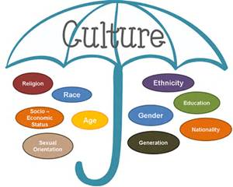
What is Culture?

Slide 7
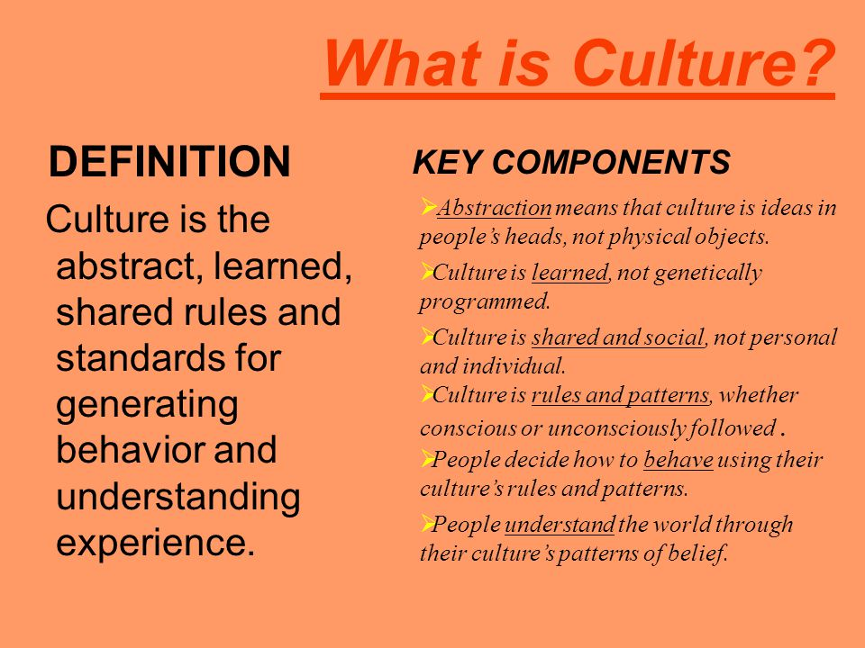
What is Culture?
A set of beliefs, norms, values
A product of such things as religion, beliefs, customs, traditions
A way of life
Positive Psychology: The Scientific and Practical Explorations of Human Strengths © 2014 SAGE

Slide 8
Culture Counts
Cultural influences must also be a part of understanding educational successes, psychological strengths, the good life
Culture: race, ethnicity, gender, sexual orientation, socioeconomic status, religion, disability, and nation of origin
Positive psychology asked to put forth more effort to pay attention to cultural influences, with a corresponding address of marginalization of minorities.
  For example, what is considered “positive” or a strength in one culture may not be in another; how a strength develops in one culture may be different from how a strength develops in another
Positive Psychology: The Scientific and Practical Explorations of Human Strengths © 2014 SAGE

Slide 9
Historical Perspective on Culture
Late 1800s & early 1900s:
- Race and culture as determinants of positive and negative personal characteristics and behavior
Dominant race or culture (European ancestry) was perceived as superior to all other races/cultural groups in the U.S.
Positive Psychology: The Scientific and Practical Explorations of Human Strengths © 2014 SAGE

Slide 10
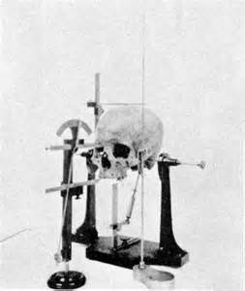
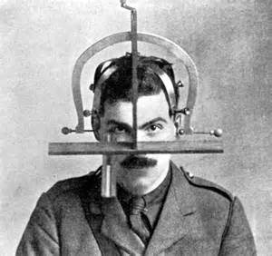
Historical Perspective on Culture
Genetically Deficient Perspective:
- biological differences cause
perceived gaps in intelligence
between racial groups
- argued “inferior” could not benefit from
growth opportunities
- pseudoscience used as support
    Craniometry (e.g., filled skull with seeds to measure capacity)
Positive Psychology: The Scientific and Practical Explorations of Human Strengths © 2014 SAGE

Slide 11
Historical Perspective on Culture
Culturally Deficient Perspective
  Focus shifted from race to culture…”cultural deficiencies”
  People lack certain psychological resources because of limited exposure to the prevailing values & customs of the day (i.e., those of European Americans)
  Deviations from normative culture = deficient
Positive Psychology: The Scientific and Practical Explorations of Human Strengths © 2014 SAGE

Slide 12

Historical Perspective on Culture
Eventually….Culturally Different Perspective:
- Uniqueness and strengths of all cultures
are recognized
Recently….Cultural Pluralism (recognizing distinct cultural entities and adopting some values of the majority group) and Cultural Relativism (interpreting behaviors within the context of the culture)
Positive Psychology: The Scientific and Practical Explorations of Human Strengths © 2014 SAGE

Slide 13
Positive Psychology:
Culture Is Everywhere
Cultural values of researchers and practitioners should not influence their work (or should they in some cases?)
A core group of positive traits (or strengths) might exist across culture, be universal, but they may manifest themselves in different ways.
Happiness is discussed as a possible defining factor of people across nations
Positive Psychology: The Scientific and Practical Explorations of Human Strengths © 2014 SAGE

Slide 14
Culturally Embedded Positive Psychology Research and Practice
Cultural values of researchers and practitioners influence their work
Positive traits may manifest in different ways for different purposes in different cultures
  P. 92: Indian student who said didn’t want to be happy; Singaporean marrying because socially expected; Korean who was choosing career to be rich (not happy) so as to bring face to his parents by buying them a Mercedes
Definitions of strengths may vary across cultural groups
  Western: achievement makes them happy; Eastern: harmony makes them happy
Positive Psychology: The Scientific and Practical Explorations of Human Strengths © 2014 SAGE

Slide 15
How To Make Sense of the Role of Culture in Positive Psychology
Research across nations (cross-culturally)
Research between cultural groups within diverse nations (like the U.S.) (multiculturally because we have within-group heterogeneity)
Qualitative and quantitative research
Positive Psychology: The Scientific and Practical Explorations of Human Strengths © 2014 SAGE

Slide 16
Strength: Hope (Examined culturally)
P. 96
Today, we will talk about the power of hope in your lives. I need to know how you understand this thing called hope. I want you to raise both hands. On the count of 3, I want you to point to where YOUR hope comes from. Given your background and all of your life experiences, where do you think your hope originates…in your head (that thinking part of you), your heart (from the love you have for others and they have for you), or from the holy (your spiritual life). You can use both hands to point to one place, or both hands to point to different places. So, on the count of 3, point to where your hope comes from
Positive Psychology: The Scientific and Practical Explorations of Human Strengths © 2014 SAGE

Slide 17
How To Make Sense of the Role of Culture in Positive Psychology
Chang’s research on optimism across cultural groups (Caucasians and Asian Americans) as an example of the importance of the equivalence of constructs across cultural groups
  Asian Americans were more pessimistic than Caucasians, but equivalent on optimism; optimism negatively correlated with general psychological symptoms and physical symptoms for Asian Americans but not for Caucasians
(Journal of Cross-Cultural Psychology, Vol 41(3), May, 2010. pp. 465-470)
Positive Psychology: The Scientific and Practical Explorations of Human Strengths © 2014 SAGE

Slide 18
How To Make Sense of the Role of Culture in Positive Psychology
Salience of Cultural Identity
  More salient cultural identity may provide sources of strength for different individuals
    Utsey et al. (2008): African Americans who adhered to a traditional African American worldview (such as valuing the importance of religion)and pride in racial heritage predicated higher well-being and positive psychological functioning; higher levels of racial pride also related to higher levels of resilience
Positive Psychology: The Scientific and Practical Explorations of Human Strengths © 2014 SAGE

Slide 19
How To Make Sense of the Role of Culture in Positive Psychology
Identification with cultural facets can influence the development, recognition, and enhancement of strengths
Anecdotal story of “The Wise Man of the Gulf” (see p . 98)
Main question: “What works for whom?”
Positive Psychology: The Scientific and Practical Explorations of Human Strengths © 2014 SAGE

Slide 20
Measuring “Universal” Strengths
Traits/characteristics can be defined differently in different cultures
There are differences between cultural groups in definitions, manifestations, and values placed on various constructs
Linguistic equivalent of a measure ≠ conceptual equivalence
Positive Psychology: The Scientific and Practical Explorations of Human Strengths © 2014 SAGE

Slide 21
Multicultural Mindsets as a Strength
Multicultural personality = ability to navigate and adapt to an increasingly diverse world
  “a strength-based cluster of personality dispositions or traits that…is hypothesized to predict cultural adjustment and quality of life outcomes in culturally heterogeneous societies” (Ponterotto et al., 2008, p. 5)
Positive Psychology: The Scientific and Practical Explorations of Human Strengths © 2014 SAGE

Slide 22
Multicultural Mindset as Strength
Multicultural Personality Questionnaire (MPQ)
  Five Factors:
    1. Cultural Empathy
    2. Open-Mindedness
    3. Emotional Stability
    4. Initiative
    5. Flexibility
Multicultural personality related to cultural adjustment and quality of life outcomes/well-being
Positive Psychology: The Scientific and Practical Explorations of Human Strengths © 2014 SAGE

Slide 23
Final Thoughts on Cultural Influences
More research required with emphasis on cultural facets
Determine how “culture counts” with every client or research participant interaction
Positive Psychology: The Scientific and Practical Explorations of Human Strengths © 2014 SAGE

Slide 24
Final Thoughts on Cultural Influences
Psychological strength is universal
- all people have strengths
There are no universal strengths
  - how strengths manifest differs in subtle and obvious ways
Positive Psychology: The Scientific and Practical Explorations of Human Strengths © 2014 SAGE

Slide 25
Final Thoughts on Cultural Influences
Life’s contexts affect how strengths are developed, defined, manifested, & enhanced
Culture is a reflection of and determinant of the life goals we value and pursue
- the good life is in the mind of the beholder
Increased emphasis on research into strengths of traditionally marginalized groups.
.
Positive Psychology: The Scientific and Practical Explorations of Human Strengths © 2014 SAGE

Slide 26
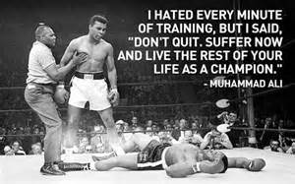
Final Summary
Agreement on These Issues:
Psychological strength is universal
There are no universal strengths.
Life context affect how strengths are developed and manifested.
Culture is a reflection and determinant of the life goals that we value and pursue
Positive Psychology: The Scientific and Practical Explorations of Human Strengths © 2014 SAGE

Slide 27
Mini-Experiments
Culturally Embedded Daily Practice
  Join professor’s lab committed to study of positive functioning of first-generation college students
  Involves developing and evaluating a mentoring program for a culturally diverse group of students
  Group brainstorms ideas about content and process of the mentoring sessions and about the salient outcome measures
  Professor Questions:
    Which of the students’ strengths are most likely to aid them in school and in life?
    Should we measure happiness as a desired outcome in addition to academic self-efficacy, performance, and retention?
    What cautions should we take with regard to the measures we choose?
    What about family of origin influence on a student’s academic behaviors?
    How might our own values affect the mentoring process or research?
Positive Psychology: The Scientific and Practical Explorations of Human Strengths © 2014 SAGE

Slide 28
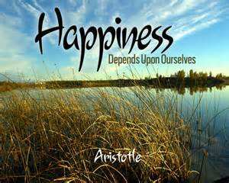
Positive Psychology: The Scientific and Practical Explorations of Human Strengths © 2014 SAGE

